Slide 1
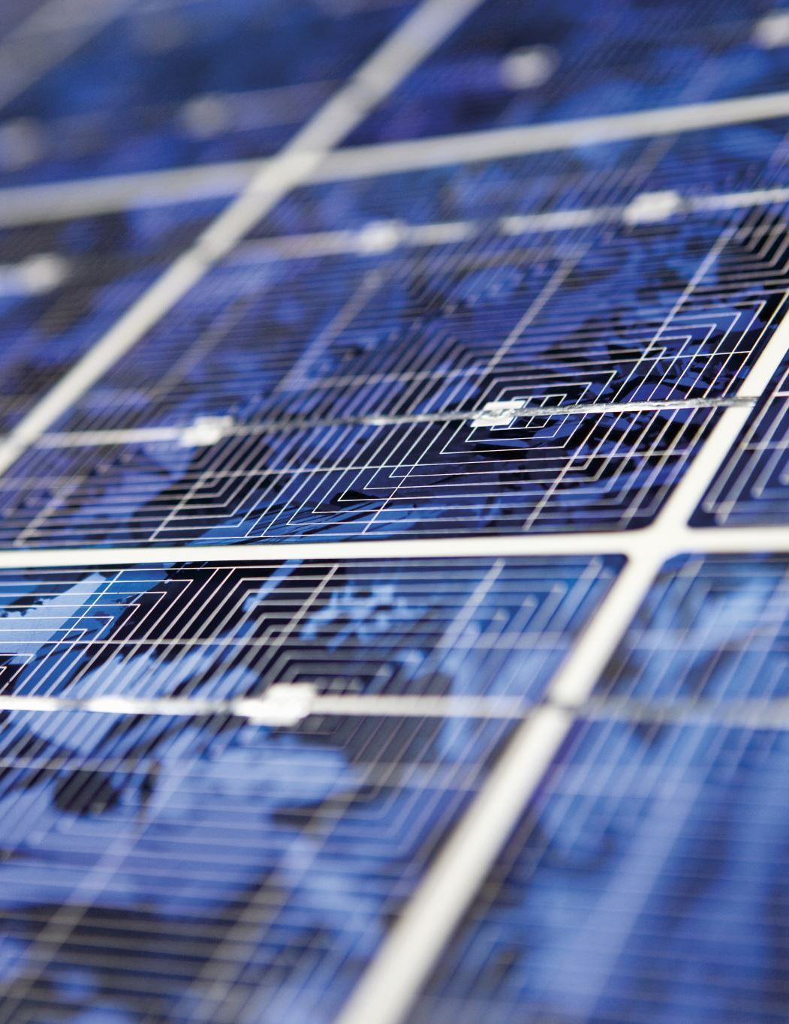
Application of Matrix Inverse

Slide 2

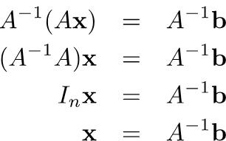
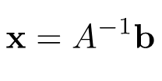
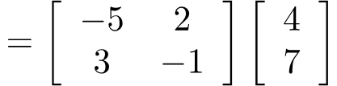
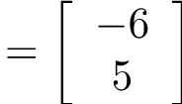

Solving Linear Equations
The inverse can be used to solve system of linear equations.
If A is invertible.
$$Ax=b$$
However, this method is computationally inefficient.

Slide 3
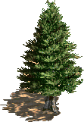






Input-output Model
假設世界上只有食物、黃金、木材三種資源
 | 需要食物 | 需要黃金 | 需要木材˙
生產一單位食物 | 0.1 | 0.2 | 0.3
生產一單位黃金 | 0.2 | 0.4 | 0.1
生產一單位木材 | 0.1 | 0.2 | 0.1
Cx
C
x
$$\left[\begin{matrix}0.1x_{1}+0.2x_{2}+0.1x_{3} \\ 0.2x_{1}+0.4x_{2}+0.2x_{3} \\ 0.3x_{1}+0.1x_{2}+0.1x_{3}\end{matrix}\right]$$
$$\left[\begin{matrix}0.1 & 0.2 & 0.1 \\ 0.2 & 0.4 & 0.2 \\ 0.3 & 0.1 & 0.1\end{matrix}\right]$$
$$\left[\begin{matrix}x_{1} \\ x_{2} \\ x_{3}\end{matrix}\right]$$
$$=$$
須投入
Consumption matrix
想生產

Slide 4
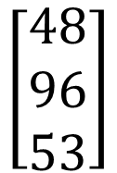
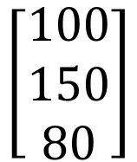
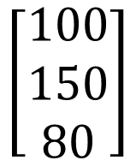

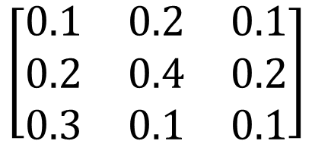
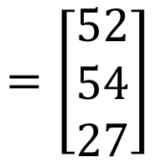
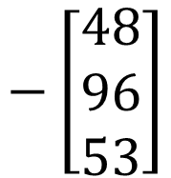

Input-output Model
Cx
C
x
$$\left[\begin{matrix}48 \\ 96 \\ 53\end{matrix}\right]$$
$$\left[\begin{matrix}0.1 & 0.2 & 0.1 \\ 0.2 & 0.4 & 0.2 \\ 0.3 & 0.1 & 0.1\end{matrix}\right]$$
$$\left[\begin{matrix}100 \\ 150 \\ 80\end{matrix}\right]$$
$$=$$
須投入
Consumption matrix
想生產
須考慮成本：
淨收益
$$\left[\begin{matrix}100 \\ 150 \\ 80\end{matrix}\right]$$
$$−\left[\begin{matrix}48 \\ 96 \\ 53\end{matrix}\right]$$
$$=\left[\begin{matrix}52 \\ 54 \\ 27\end{matrix}\right]$$
Demand
Vector d
$$x−Cx=$$

Slide 5
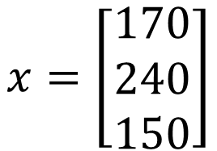

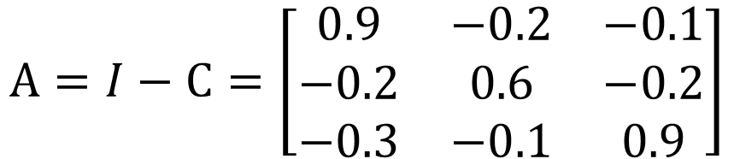

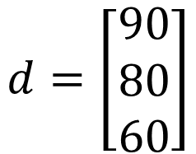
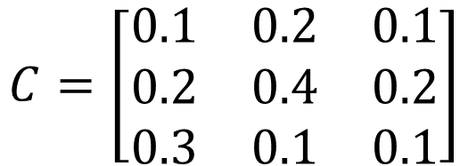

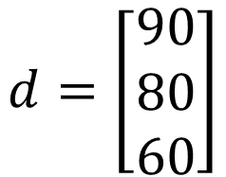
Input-output Model
$$C=\left[\begin{matrix}0.1 & 0.2 & 0.1 \\ 0.2 & 0.4 & 0.2 \\ 0.3 & 0.1 & 0.1\end{matrix}\right]$$
$$d=\left[\begin{matrix}90 \\ 80 \\ 60\end{matrix}\right]$$
Demand
Vector d
生產目標 x 應該訂為多少?
$$A=I−C=\left[\begin{matrix}0.9 & −0.2 & −0.1 \\ −0.2 & 0.6 & −0.2 \\ −0.3 & −0.1 & 0.9\end{matrix}\right]$$
$$x−Cx=d$$
$$Ix−Cx=d$$
$$d=\left[\begin{matrix}90 \\ 80 \\ 60\end{matrix}\right]$$
$$x=\left[\begin{matrix}170 \\ 240 \\ 150\end{matrix}\right]$$
$$\left(I−C\right)x=d$$
Ax=b

Slide 6






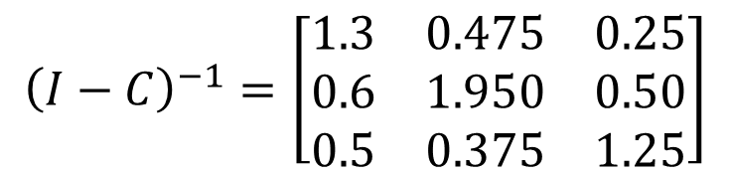

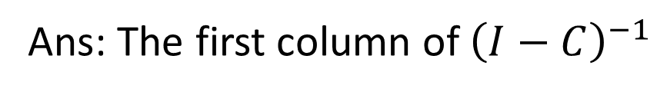
Input-output Model
提升一單位食物的淨產值，需要多生產多少資源？
Ans: The first column of ${\left(I−C\right)}^{−1}$
$$\left(I−C\right)x=d$$
$$x={\left(I−C\right)}^{−1}d$$
$$d+\left[\begin{matrix}1 \\ 0 \\ 0\end{matrix}\right]$$
$$x′={\left(I−C\right)}^{−1}\left(d+e_{1}\right)$$
$$d$$
$$=d+e_{1}$$
$$={\left(I−C\right)}^{−1}d+{\left(I−C\right)}^{−1}e_{1}$$
$${\left(I−C\right)}^{−1}=\left[\begin{matrix}1.3 & 0.475 & 0.25 \\ 0.6 & 1.950 & 0.50 \\ 0.5 & 0.375 & 1.25\end{matrix}\right]$$
食物
黃金
木材

